Slide 1
Code check: Counterpumping
Yi-Hao Chen
3/31/2022

Slide 2
Comparison with
Lindberg et al., Accurate modeling of high-repetition rate ultrashort pulse amplification in optical fibers, Sci. Rep. 6, 34742 (2016)
Input seed: 375-mW, 212-MHz, 1041-nm, 173-fs transform-limited pulse
Fiber: Nufern 20/400 Yb-doped PM fiber (0.5 dB/m absorption @ 915 nm)
Pump: 976 nm counterpumping

Slide 3
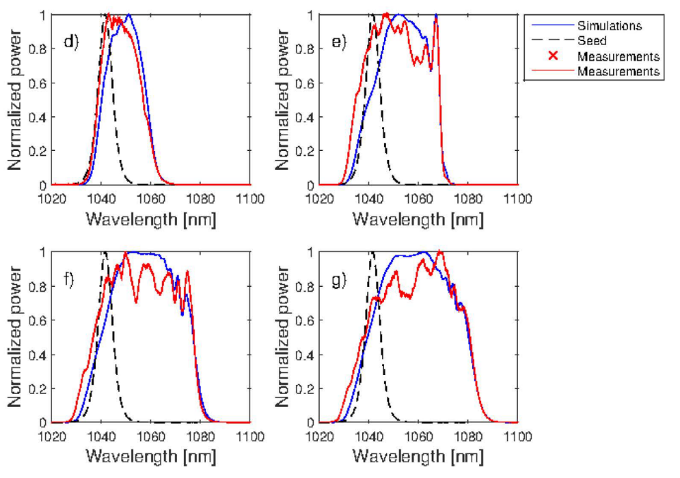
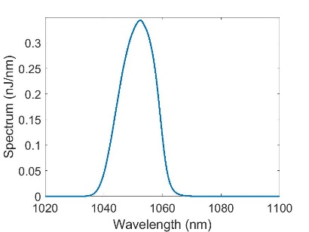
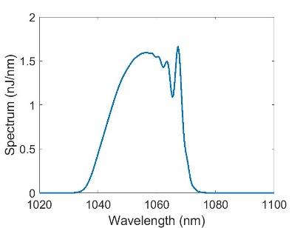
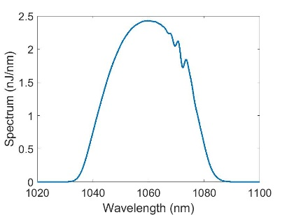
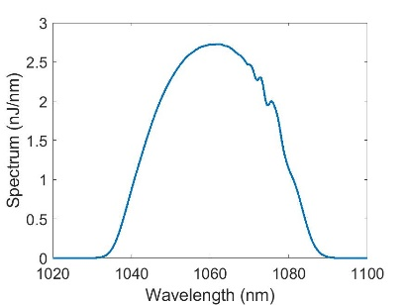








Results
Perfect match!
Linberg’s
Mine
$E_{pulse}$: 1.1 W
$E_{pulse}$: 8.4 W
$E_{pulse}$: 1.07 W
$E_{pulse}$: 8.48 W
$E_{pulse}$: 16.2 W
$E_{pulse}$: 20.3 W
$E_{pulse}$: 16.7 W
$E_{pulse}$: 20.7 W
Pump powers used in Simulations above:
2.7 W, 12.6 W, 23.4 W, 27.9 W

